Slide 1
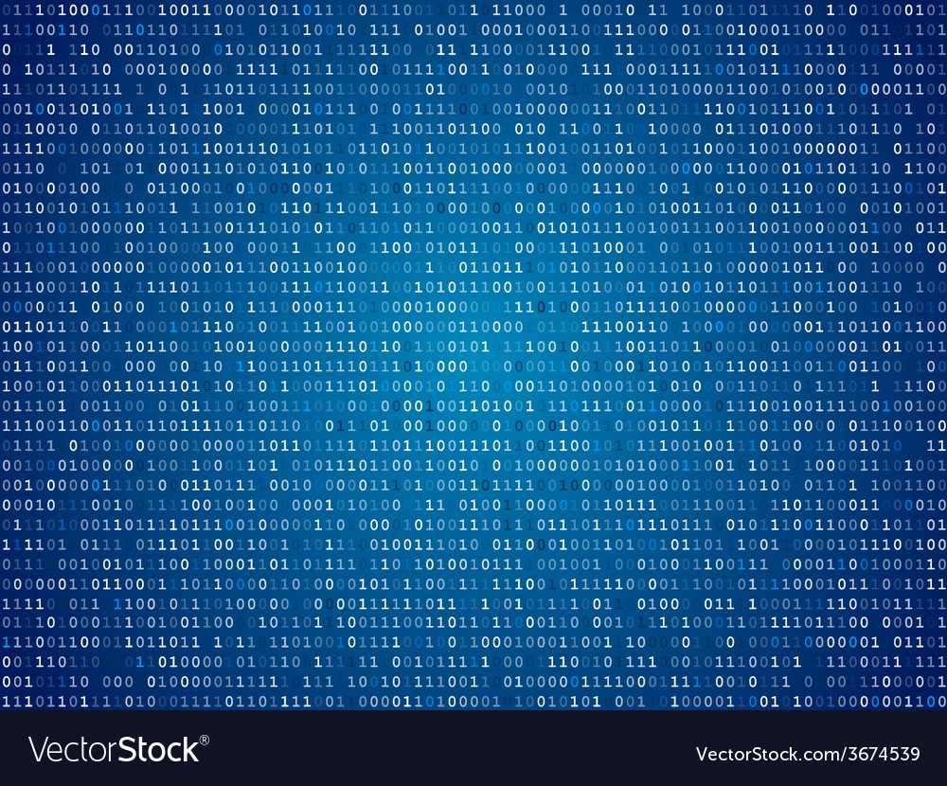
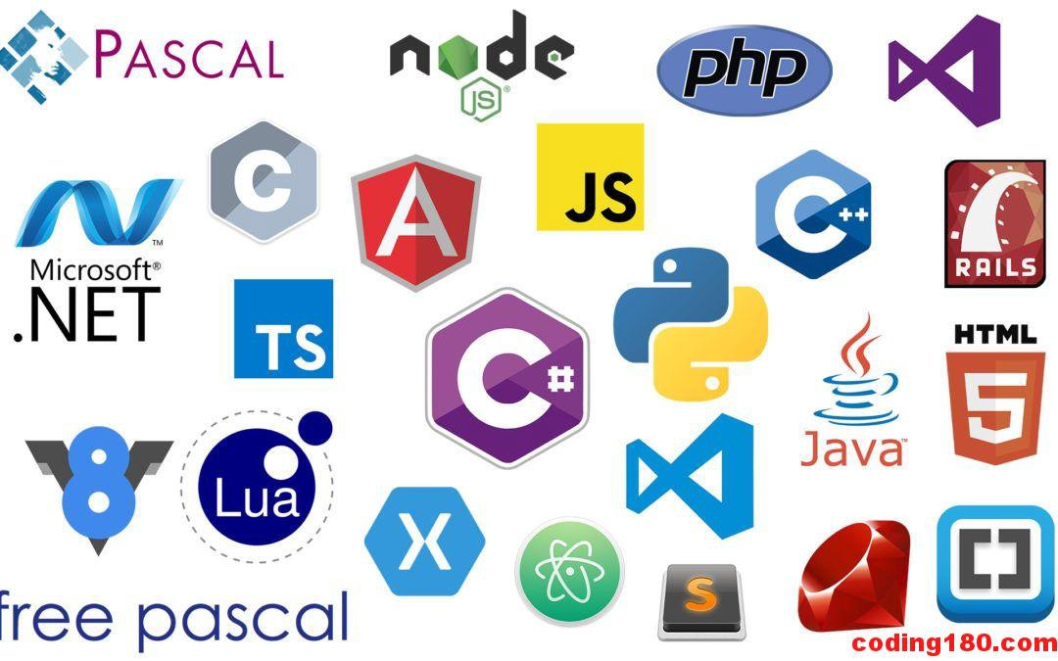
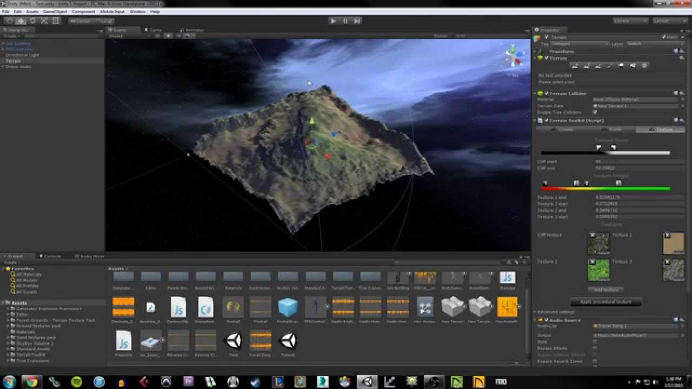
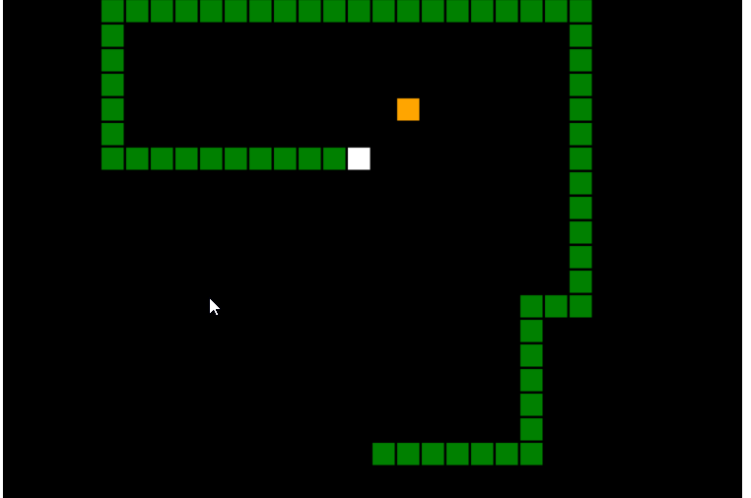
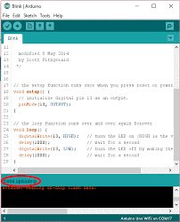
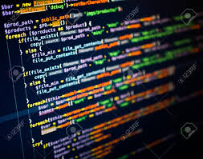
Programming Merit Badge 2

Slide 2
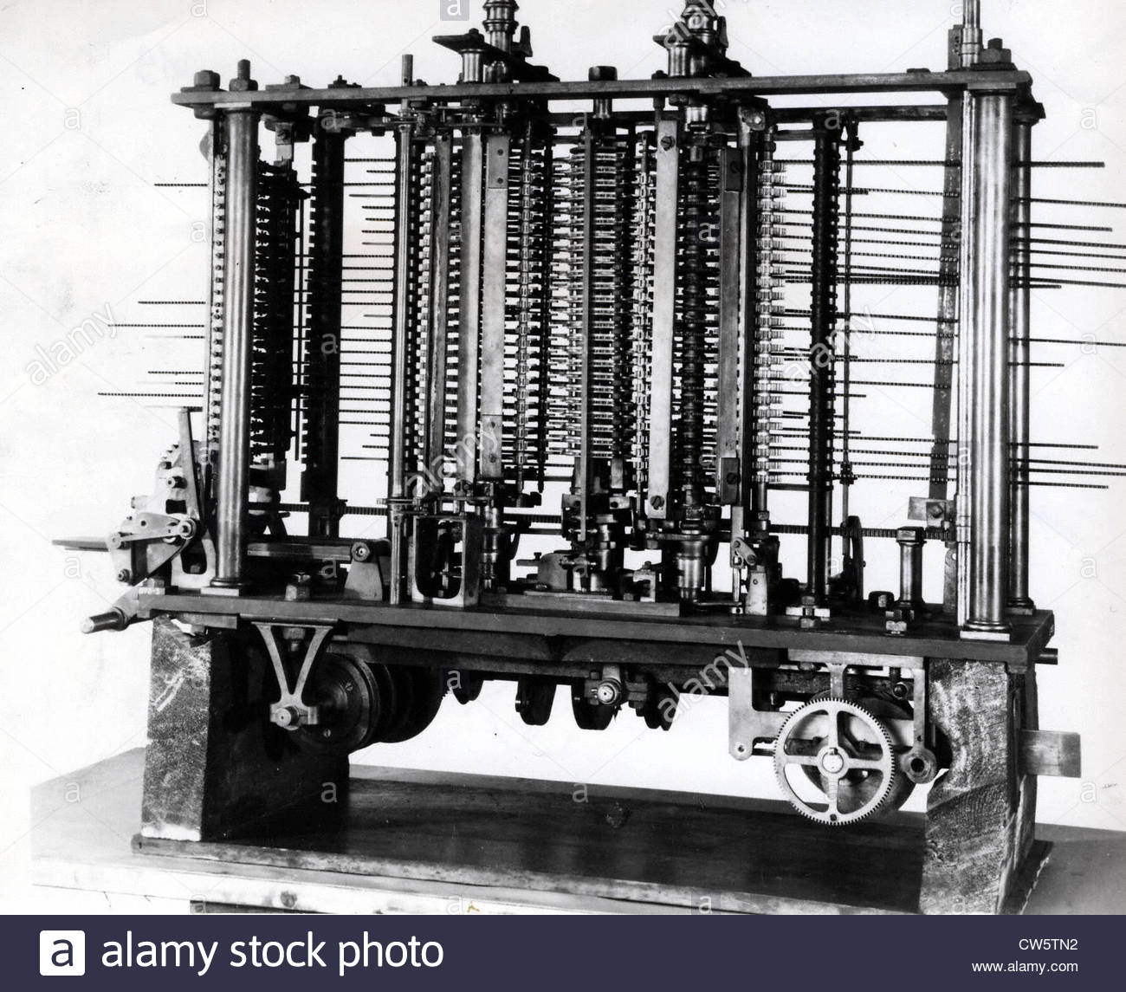
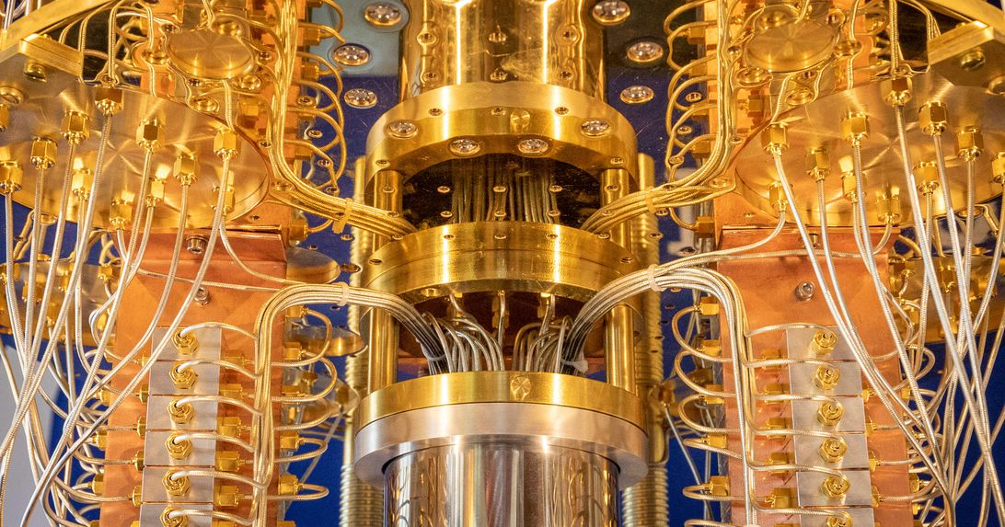
History
You can’t tell where you are going if you do not know where you’ve been
IBM’s 53 Quantum Computer - Qiskit
Babbage’s Analytic Engine – Punch Cards

Slide 3
In the beginning
Charles Babbage in 1836 addressed a problem with a specific solution
It could calculate of mathematical functions or formulas and save mathematicians time
Mechanical solution that had input, output, central processing, and memory

Slide 4
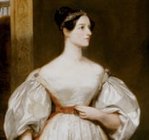
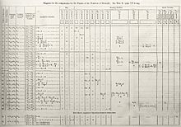
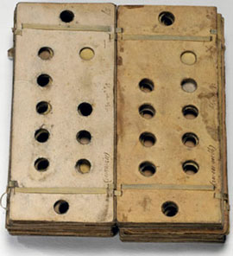
Programming the Analytic Engine
Charles Babbage had a design but did not have a formal way to turn instructions into action
Lady Augusta Ada King was the child of the poet Lord Byron. She was a gifted mathematician who wrote the first algorithm for the Analytic Engine in 1843
She is considered to be the “Mother of Programming”

Slide 5
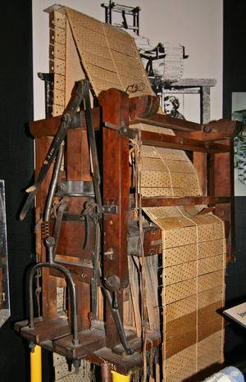
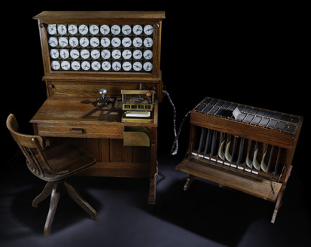
Computers become electronic
In the 1800’s a Frenchman named Joseph Jacquard developed a new way to weave using punch cards called the Jacquard Loom.
This concept was later adapted by Herman Hollerith in 1890’s to address census issue and founded the Tabulating Machine Company in 1896
Electronic connections made through open holes in cards spun the dials and reduced the time from 144.5 hours to 5.5!

Slide 6

Computers Evolve as does Programming
Computing for Military Science
In the1945 computers like the Electronic Numerical Integrator and Computer known as ENIAC. It used vacuum tubes and relays to handle more generic tasks.
Expensive and used by the military for artillery table calculations
Thought in binary (1 or 0 true or false)
More general purpose requires general purpose programming

Slide 7
Programming Evolves
You’re Welcome, Future Programmers!
John von Neuman
Hungarian-American mathematician, physicist, computer scientist. Foremost of his time and a founding figure in Computing!
Worked on the ENIAC as well as Manhattan project and other major efforts of the day
Introduced subroutines, control logic, merge sort, and contributed to AI with Turing

Slide 8
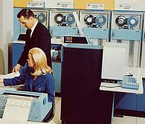
Computing moves to the business world
Computing for business
In the 1960’s computers became engineered general-purpose machines to solve business problems like accounting, procurement, inventory
Remember the Tabulating Machine Company? It grew into a company called International Business Machines (IBM)
Mainframes used Assembly Language, COBOL, JCL and other languages that were built for business not mathematical problems.

Slide 9
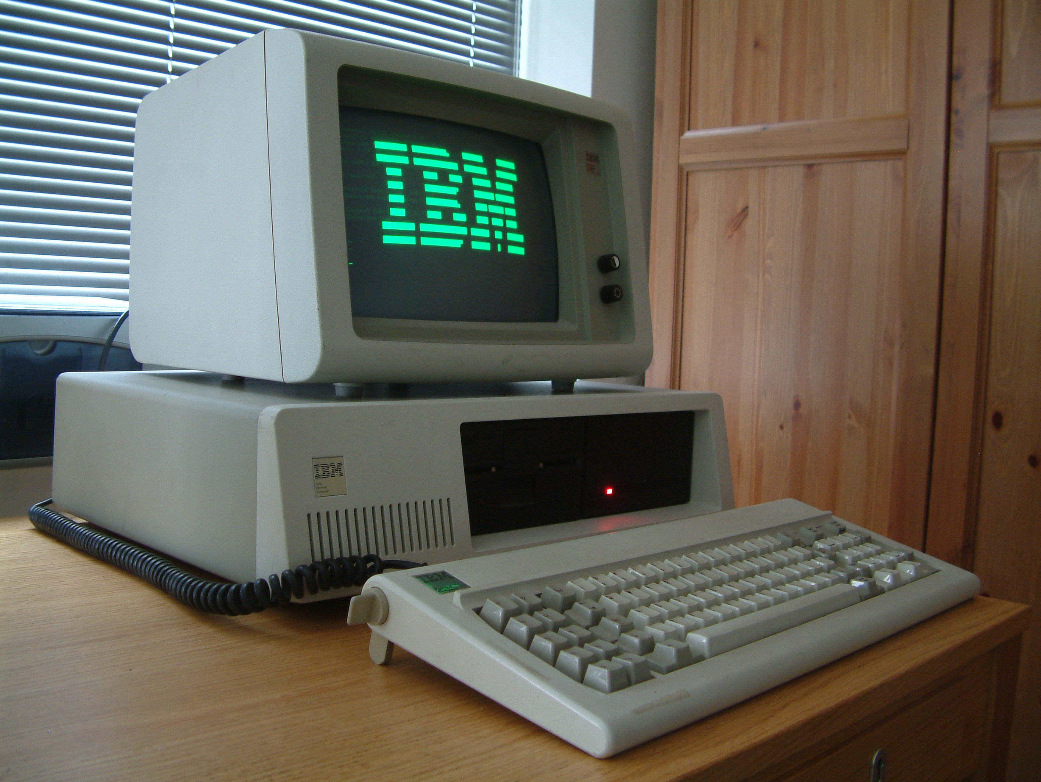
Computing moves to our homes
Computing for people
In the 1980’s computers moved out of the backroom and onto the desktop
Computers were based on more efficient transistors and semiconductors which enabled smaller and faster solutions
Programming evolved to meet this new demand with new versions of assembly and other languages that evolved from BASIC, C, Pascal that were used on minicomputers and mainframes

Slide 10
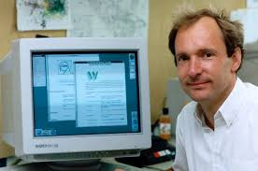
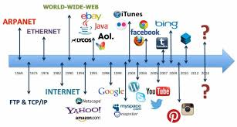
Enter the World Wide Web
The world is connected
In 1989 Sir Tim Berners-Lee a British computer scientist at CERN changed the world by inventing the world-wide-web
In 1991 the first web server became active and now we have over 1.5 billion today
Much of what we think of as the internet today rests with his idea of hypertext document sharing over new protocols consumed by browsers
Programming languages evolved to take advantage of this including Java, C, PHP, Javascript, Python, and many others!

Slide 11

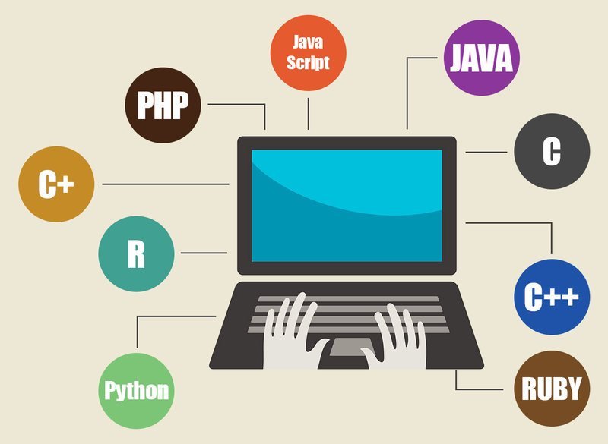

Cloud Computing
A new cycle begins
In 2006 Amazon began offering the computing infrastructure and services that powered its business to other companies
Cloud computing allows companies to scale up and down without huge investments and provides new innovative ways to solve problems
Soon after, Microsoft, Google, and others followed suite and we have seen programming languages evolve to this space as well!

Slide 12
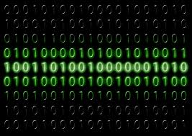
Understanding how computers think
Binary represents a discrete state. Things are either True (1) or False (0)
Computers think in a combination of True or False states represented by voltage
On a pc this is typical DC Volts of 5V for True 0V for false
The combination of True and False are represented as logic gates and is the foundation for programming

Slide 13
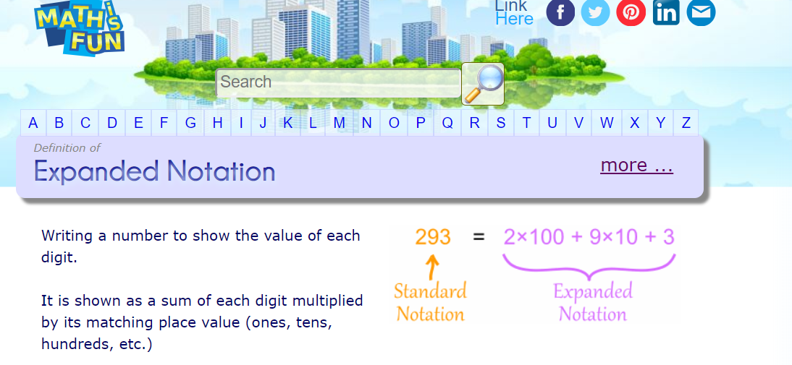
Let’s revisit Decimal

Slide 14
Binary Equivalent
243 = 11110011
1x2⁷ + 1x2⁶ + 1x2⁵ + 1x2⁴ + 0x2³ + 0x2² + 1x2¹ + 1x2⁰
128 + 64 + 32 + 16 + 0 + 0 + 2 + 1

Slide 15
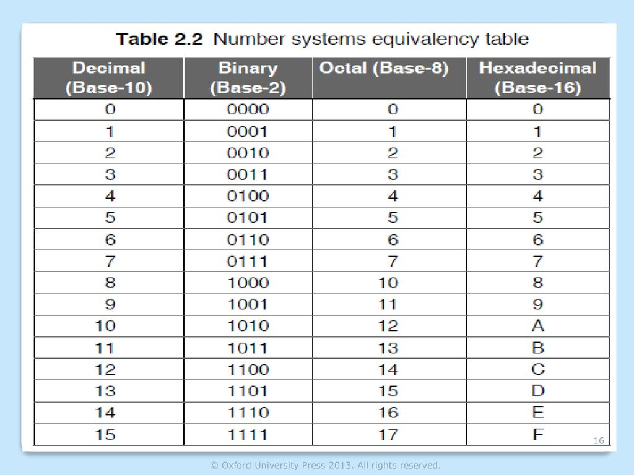
Other formats
Programmers think in other formats
Common formats are Hexadecimal (base 16) and Octal (base 8)
What would 177 Hexadecimal be if converted to Decimal?
What is 9 + 1 equal to in Hex?

